Slide 1


Obrada i optimizacija upita kod SQLite baze
Sistemi za upravljanje bazama podataka
Student:
Todor Majstorovic 1088
Profesor:
Doc dr. Aleksandar Stanimirović

Slide 2

Sadržaj
SQLite
Proces obrade SQL upita
SQLite Indeksi
Optimizator upita SQLite
NGQP

Slide 3
SQLite
Prednosti
Integrisana baza podataka
Cross-platform
Brzina
Pouzdanost
Mane
Ne garantuje integritet domena
Veličina do 2GB
Nepogodna za projekte sa mnogo HTTP zahteva

Slide 4
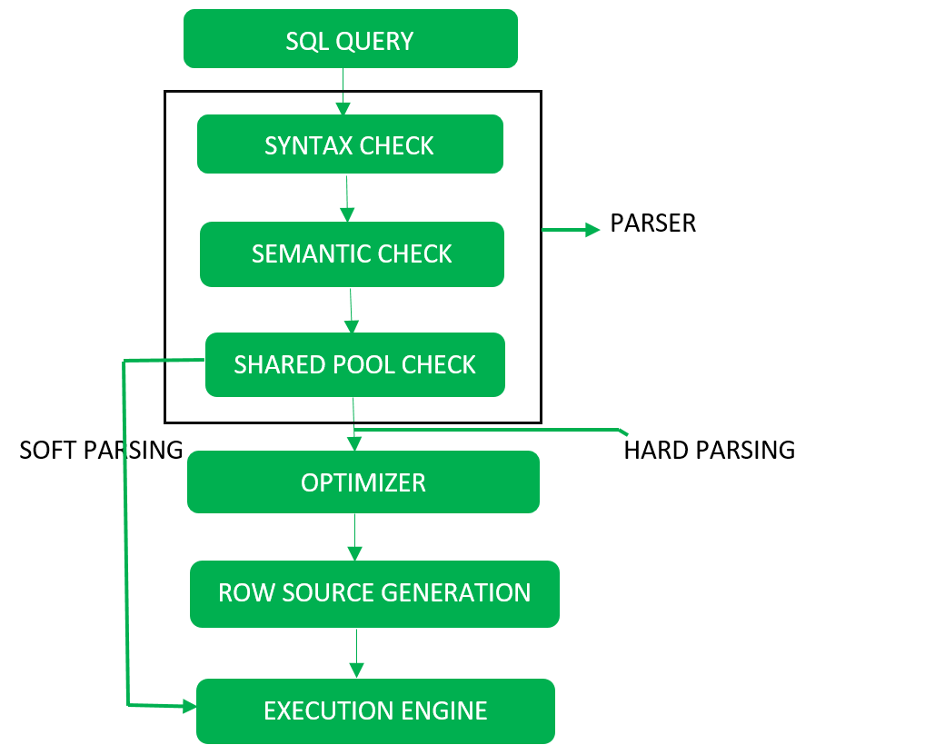
Proces obrade SQL upita

Slide 5
SQLite indeksi
B-stablo. O(log n)
Upiti pomoću jednakosti (=) i opsega (>, >=, <,<=) izuzetno efikasni

Slide 6
Optimizator upita SQLite
WHERE
BETWEEN
OR
LIKE
Skip-Scan
JOIN
Odabir najboljeg indeksa
Covering Indice
Automatic Index

Slide 7
WHERE analiza
BETWEEN optimizacija
column = expression
column IS expression
column > expression
column >= expression
column < expression
column <= expression
expression = column
expression > column
expression >= column
expression < column
expression <= column
column IN (expression-list)
column IN (subquery)
column IS NULL
expr1 BETWEEN expr2 AND expr3
expr1 >= expr2 AND expr1 <= expr3
CREATE INDEX idx_ex1 ON ex1(a,b,c,d,e,...,y,z);
WHERE a=5 AND b IN (1,2,3) AND c>12 AND d='hello'

Slide 8
OR optimizacija
column = expr1 OR column = expr2 OR column = expr3
column IN (expr1,expr2,expr3)
rowid in (SELECT rowid FROM table WHERE expr1 UNION SELECT rowid FROM table WHERE expr2
UNION SELECT rowid FROM x WHERE expr3)
Konceptualna transformacija
Poseban indeks za svaki podizraz
LIKE optimizacija

Slide 9
The Skip-Scan Optimization
CREATE TABLE people(
name TEXT PRIMARY KEY,
role TEXT NOT NULL,
height INT NOT NULL, -- in cm
CHECK( role IN ('student','teacher') )
);
CREATE INDEX people_idx1 ON people(role, height);
SELECT name FROM people WHERE height>=180;
SELECT name FROM people WHERE role='teacher' AND height>=180
UNION ALL
SELECT name FROM people WHERE role='student' AND height>=180

Slide 10
JOIN optimization
CREATE TABLE node(
id INTEGER PRIMARY KEY,
name TEXT
);
CREATE INDEX node_idx ON node(name);
CREATE TABLE edge(
orig INTEGER REFERENCES node,
dest INTEGER REFERENCES node,
PRIMARY KEY(orig, dest)
);
CREATE INDEX edge_idx ON edge(dest,orig);
1. Opcija
foreach n1 where n1.name='alice' do:
foreach n2 where n2.name='bob' do:
foreach e where e.orig=n1.id and e.dest=n2.id
return n1.*, n2.*, e.*
end
end
end
2. Opcija
foreach n1 where n1.name='alice' do:
foreach e where e.orig=n1.id do:
foreach n2 where n2.id=e.dest and n2.name='bob' do:
return n1.*, n2.*, e.*
end
end
end
SELECT *
FROM edge AS e,
node AS n1,
node AS n2
WHERE n1.name = 'alice'
AND n2.name = 'bob'
AND e.orig = n1.id
AND e.dest = n2.id;
Zavisi od konkretnih tabela n1, n2 i e, ANALYZE komanda
Manual control - SQLITE_STAT tabele
CROSS JOIN

Slide 11
Odabir najboljeg indeksa
CREATE TABLE ex2(x,y,z);
CREATE INDEX ex2i1 ON ex2(x);
CREATE INDEX ex2i2 ON ex2(y);
SELECT z FROM ex2 WHERE x=5 AND y=6;
Automatic index
CREATE TABLE t1(a,b);
CREATE TABLE t2(c,d);
-- Insert many rows into both t1 and t2
SELECT * FROM t1, t2 WHERE a=c;
Estimira na osnovu statistike!!!
Odbacivanje indeksa korisnjem operatora +
O(n logn)
SELECT z FROM ex2 WHERE +x=5 AND y=6;
Covering index

Slide 12
NGQP
QPSG
NN vs N nearest neighbor
Low quality index with ANALYZE
Likelihood unlikely
Explain query plan
NN R-N1-N2-S-C-O-L-P cena 36.92
N10 P-L-O-C-N1-R-S-N2 cena 27.38
N10 750x brze
CREATE TABLE composer( cid INTEGER PRIMARY KEY, cname TEXT );
CREATE TABLE album( aid INTEGER PRIMARY KEY, aname TEXT );
CREATE TABLE track( tid INTEGER PRIMARY KEY, cid INTEGER REFERENCES composer, aid INTEGER REFERENCES album, title TEXT );
CREATE INDEX track_i1 ON track(cid); CREATE INDEX track_i2 ON track(aid);
SELECT DISTINCT aname FROM album, composer, track WHERE cname LIKE '%bach%' AND composer.cid=track.cid AND album.aid=track.aid;
Bira se track-composer-album
SELECT DISTINCT aname FROM album, composer, track WHERE likelihood(cname LIKE '%bach%', 0.05) AND composer.cid=track.cid AND album.aid=track.aid;
Bira se najoptimalniji spoj, composer-track-album

Slide 13
HVALA NA PAŽNJI!

